Slide 1

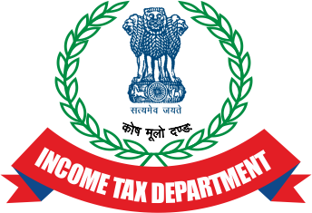

Recent development in the field of survey, search and seizure under income tax act,1961
DATE: 25TH JANUARY 2022
BY: CA (DR.) SHARDUL SHAH
ORGANIZED BY: NAGPUR BRANCH OF WIRC OF ICAI

Slide 2

SCOPE OF DISCUSSION
APPLICABLE PROVISIONS INTERPRETATION(SECTIONS).
WHAT IS SURVEY, SEARCH & SEIZURE UNDER INCOME TAX ACT, 1961.
3. WHEN SURVEY IS CONVERTED INTO SEARCH.
4. SEARCH AND SEIZURE ASSESSMENT
5. CIRCULAR AND NOTIFICATION UPDATE ABOUT SEARCH AND SEIZURE CASES.
6. LATEST NEWS UNDER SEARCH AND SEIZURE.
7. SEARCHES AT A NEW HIGH AS TAX OFFENSES GET MONEY-LAUNDERING TINT.
8. READ ALONG WITH THE ENFORCEMENT DIRECTORATE (ED)

Slide 3
SCOPE OF DISCUSSION
9. BENAMI TRANSACTION (PROHIBITION) ACT INTERPLAY
10. PROSECUTION UNDER INCOME TAX ACT-1961.
11. INDIA NEEDS TO WIDEN ITS TAX BASE.

Slide 4
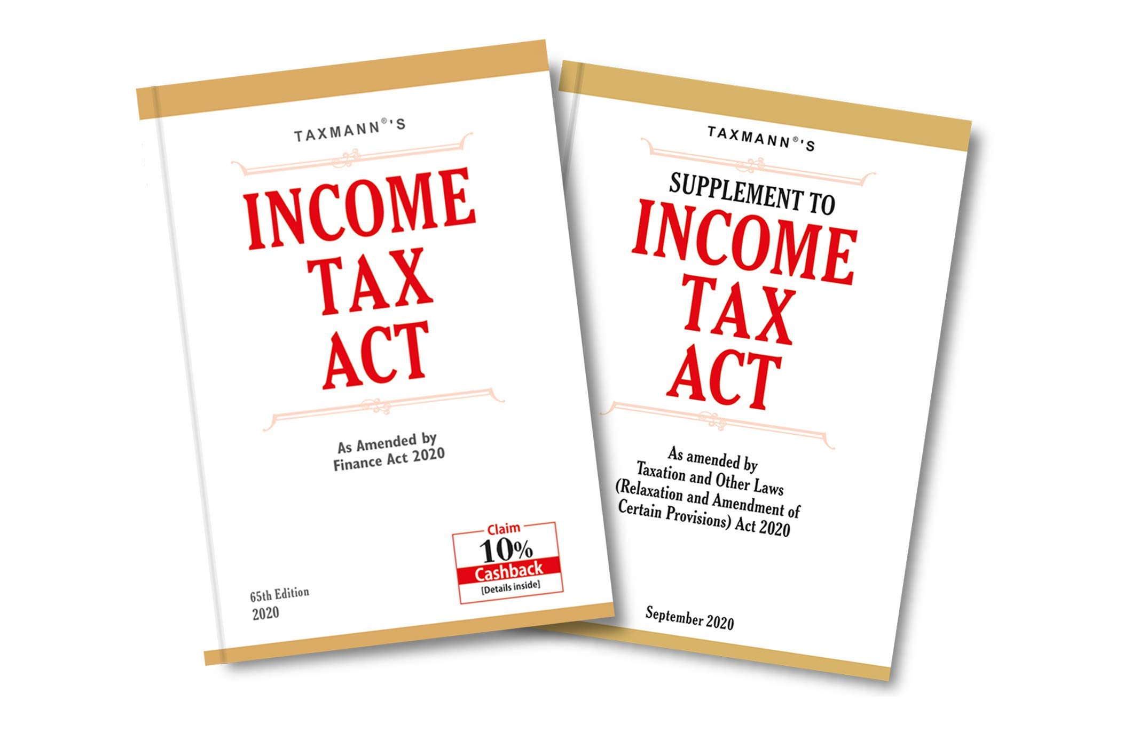
Applicable provision(sections)
Search and Seizure [Section 132]:
Under this section, wide powers of search and seizure are conferred on the income-tax authorities. (i) Authorities empowered to issue authorization
[Section 132(1)]: Search and seizure can be authorized by Principal Director General or Director-General or Principal Director or Director or the Principal Chief Commissioner or Chief Commissioner or Principal Commissioner or Commissioner. However, the said operations can be authorized by Additional Director or Additional Commissioner or Joint Director or Joint Commissioner if they are empowered by the Board. The authorities mentioned above (Authorising officer) shall authorize their subordinates (Authorised officer)

Slide 5
Applicable provision(sections)
(iii) Powers in the exercise of search
The Income-tax Act gives very wide powers to an authorized officer to carry out the search and also to seize documents and unaccounted assets. The authorized officer has the power to:
Enter and search any building, place, etc. where he has reason to suspect that books of account, other documents, money, bullion, jewelry, or other valuable article or thing representing undisclosed income are kept;
Break open the locks, where the keys thereof are not available;
Carry out a personal search of the person who is suspected to have secreted some item as mentioned in a) above;
Seize the items as mentioned in a) above;
Place marks of identification and takes extracts or copies of the books of account and other documents; and
Make a note or inventory of the valuables found during the search.

Slide 6
Applicable provision(sections)
The authorized officer is also permitted to pass orders placing a prohibition on the person in possession or control of the valuable article or thing from removing, parting with, or otherwise dealing with such article or thing without prior permission. The authorized officer also has the right to demand the services of any Police officer or any officer of the Central Government.
2.2.1 The authorized officer cannot seize stock-in-trade of a business and he can only make a note of inventory of such stock-in-trade. Irrespective of nature of business and stock held for such business whether it is jewelry, bullion, or any other valuable article or thing if such material is held by a person searched as stock-in-trade of his business, the same cannot be seized.

Slide 7
Circumstances in which search can be carried out
Circumstances in which search can be carried out
The powers of search can be exercised when the authorised officer has reason to believe that:
Any person has omitted or failed to produce books of account or documents as required by any summons or notice issued,
Any person to whom, when so summoned to produce the documents, etc., will not or would not produce books of account or documents,
Any person is in possession of money, bullion, jewellery or other valuable article or thing representing, income or property which has not been disclosed or would not be disclosed for purposes of the Income-tax Act.

Slide 8
Applicable provision(sections)
Who can authorize search
The authorization to carry out the search can be given by the Principal Director General, Director General, Principal Director of Income Tax, Director of Income Tax, Principal Chief Commissioner of Income Tax, Chief Commissioner of Income Tax, and Commissioner of Income Tax only.
Authority who can execute and carry out search
However, the search warrant can be executed by any Additional Director or Additional Commissioner, Joint Director, Joint Commissioner, Assistant Director or Deputy Director, Assistant Commissioner or Deputy Commissioner of Income Tax Officer and they can be authorized to carry out actual search and seizure.

Slide 9

Applicable provision(sections)
Guidelines for seizure of jewellery and ornaments in course of search
The CBDT has vide instruction No. 1916 dated 11th May 1994, issued guidelines for the seizure of jewellery and ornaments in course of search. The said guidelines, which is reported in (1994) 120 Taxation (St.) 98, is reproduced below.
‘Instances of seizure of jewellery of small quantity in course of operations under section 132 have come to the notice of the Board. The question of a common approach to situations where search parties come across items of jewellery, has been examined by the Board and the following guidelines are issued for strict compliance:—
In the case of a wealth-tax assessee, gold jewellery and ornaments found in excess of the gross weight declared in the wealth-tax return only need to be seized.
In the case of a person not assessed to wealth-tax, gold jewellery and ornaments to the extent of 500 gms. per married lady, 250 gms. per unmarried lady and 100 gms. per male member of the family, need not be seized.

Slide 10
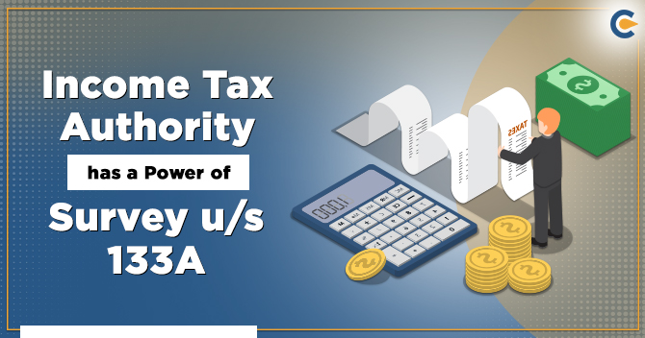
Power of Survey – Section 133A
Extent of powers of survey
An Income Tax Authority can exercise following powers during survey:
To inspect books of account and other documents,
To place marks of identification on books of account or documents examined,
To make extracts or copies of books of account or documents,
To impound books of account or other documents. However, the same cannot be retained beyond ten working days without prior approval of Chief Commissioner of Income Tax or Director General.
Though the survey party can visit during survey only a place of business, but if the party surveyed states that any books or other things relating to business are kept at a place other than place of business, then power to visit and survey such place is also available to the officers carrying out survey.

Slide 11
Whether books, cash, valuables, etc. can be seized or impounded during survey
By Finance Act, 2002, the law has been amended to empower the Income Tax Authority to impound and retain in his custody books of account or other documents inspected by him during the survey, after recording his reasons for doing so. However the power to impound is restricted to only books and documents and does not extend to cash, valuables, and other assets found.
According to S. 292C of the Act, where any books of account, other documents, money, bullion, jewelry, or other valuable articles are found in the possession of any person during a search, it is presumed that such documents, etc. belong to that person. This presumption is rebuttable.
This section provides that such presumption will also apply in respect of books of account, documents, etc. in the possession or control of any person in the course of survey operation u/s. 133A. This presumption is also extended to books of account, documents etc. delivered to the requisition officer u/s. 132A.

Slide 12
Applicable provision(sections)
Exercise of power of survey for verification of TDS/TCS [Section 133A(2A)]: An income-tax authority may, for the purpose of verifying that tax has been deducted or collected at source in accordance with the provisions of Chapter XVII-B or Chapter XVII-BB, as the case may be, enter-
Any Office, or a place where business or profession is carried on, within the limits of the area assigned to him, or
(b) any such place in respect of which he is authorized for the purposes of this section by such income-tax authority who is assigned the area within which such place is situated, where books of account or documents are kept. The income-tax authority may for this purpose enter an office, or a place where business or profession is carried on after sunrise and before sunset. Further, such income-tax authority may require the deductor or the collector or any other person who may at the time and place of the survey be attending to such work,—
to afford him the necessary facility to inspect such books of account or other documents as he may require and which may be available at such place, and
(b) to furnish such information as he may require in relation to such matter.

Slide 13
WHAT IS SURVEY, SEARCH & SEIZURE UNDER INCOME TAX ACT, 1961
The expression "survey" means general view, casting of eyes or mind over something, inspection or investigation of the condition, amount, etc. of something, account given of result of this, etc.
In short, the term 'survey' in the context of the Income Tax Act means a collection of data or information for the purposes of the Act.
Search means to look out, to seek or to find something the presence of which is suspected, etc. Seize means to take possession of goods, contrary to the wishes of the owner or to take forcible possession.
From the income tax point of view, in common parlance search is referred to as RAID. However, there is no such term as raid anywhere in income tax law.

Slide 14

When survey is converted into search
Proceedings under Section 133A, 133B, and 132 are independent of each other,
The object and scope of action under each of these actions are well defined.
A survey can lead to search only when on the basis of the information collected in the survey; conditions laid down in clauses (a), (b), (c) of Section 132 (1) are satisfied.
Similarly, persistent failure on the part of the assessee to show cooperation with the Income Tax Authorities in the matter of survey may also result in income tax raid leading to search and seizure.

Slide 15

Adjustment of Assets seized u/s.132 or requisition u/s. 132A
Section 132B provides that the asset seized u/s.132 or requisition u/s. 132A may be adjusted against the amount of existing liability under the Income-tax Act and the amount of liability determined on completion of assessment.

Slide 16

Rights of the person searched
To see the warrant of authorization duly signed and sealed by the issuing authority.
To verify the identity of each member of the search party before the start of the search and on the conclusion of the search.
To insist on personal search of ladies being taken only by a lady, with strict regard to decency.
To have at least two respectable and independent residents of the locality as witnesses.
A lady occupying an apartment being searched has a right to withdraw before the search party enters, if, according to custom, she does not appear in public.
To call a medical practitioner in case of emergency.
To allow the children to go to school, after checking their bags.
To have the facility of having meals, etc., at the normal time.

Slide 17
Rights of the person searched (contd.)
To have an inspection of the seized books of account, etc., or to take extracts therefrom in the presence of any of the authorized officers or any other person empowered by him.
To make an application objecting to the approval given by the Commissioner of Income-tax for retention Of books and documents beyond 180 days from the date of the seizure.

Slide 18
Duties of the person searched
To allow free and unhindered ingress into the premises.
To see the warrant of authorization and put signature on the same.
To identify all receptacles in which assets or books of account and documents are kept and to hand over keys to such receptacles to the authorized officer.
To identify and explain the ownership of the assets, books of account, and documents found on the premises.
To identify every individual on the premises and to explain their relationship to the person being searched. He should not mislead by impersonation. If he cheats by pretending to be some other person or knowingly substitutes one person for another, it is an offense punishable under section 416 of the Indian Penal Code.
Not to allow or encourage the entry of any unauthorized person into the premises.

Slide 19
Duties of the person searched ( contd.)
If he refuses to answer a question on a subject relevant to the search operation, he shall be punishable with imprisonment or fine or both, under section 179 of the Indian Penal Code.
Being legally bound by an oath or affirmation to state the truth, if he makes a false statement, he shall be punishable with imprisonment or fine or both under section 181 of the Indian Penal Code.
Similarly, if he provides evidence that is false and which he knows or believes to be false, he is liable to be punished under section 191 of the Indian Penal Code.
To affix his signature on the recorded statement, inventories, and the panchanama.
To ensure that peace is maintained throughout the duration of the search, and to co-operate with the search party in all respects so that the search action is concluded at the earliest and in a peaceful manner.
Similar co-operation should be extended even after the search action is over, so as to enable the authorized officer to complete necessary follow-up investigations at the earliest.

Slide 20

Do’s and Don’ts for assessees
Return of income should be filed within the time limit prescribed.
Copies of returns of income filed should be properly documented. Though your tax representative may be having and maintaining complete tax records, it is necessary that a copy of income tax and wealth tax returns filed are kept at office premises and in case of individuals, it should also be maintained at residence for all family members.
Books of account are maintained properly and up-to-date.
You may be called upon to explain any document, loose papers, etc. found during search or survey. As such, care should be taken to maintain papers in proper manner.
Investments made in assets should be properly accounted and supporting evidence should be available to substantiate the investment made.
Ornaments belonging to different members of the family should be kept separately. It is advisable to keep lists of the ornaments of each person and also where the ornaments are kept. Valuation report of a jeweller can be obtained. Also Tax records substantiating such ownership should be available at residence.

Slide 21
Do’s and Don’ts for assessees (contd.)
g.)Statement recorded at the time of search are very crucial. The person making statement is advised to state truly, correctly, fully and completely. Reply should not be vague or evasive. One should be very cautious and careful while answering the question and the person should not panic.
h.)Further, necessary co-operation should be made with the authorised officers. As per amendment made by the Finance Act, 2002, if a person who is required to afford the authorised officer the necessary facility to inspect the books of account or other documents maintained in electronic form, fails to afford such facility to the authorised officer, he shall be punishable with rigorous imprisonment for a term which may extend to two years and shall also be liable to fine.

Slide 22

SEIZURE
`Seizure’ means forcibly taking over possession from the owner or person who has possession and who is unwilling to part with possession
Only an `undisclosed asset’ could be subjected to seizure [section 132(iii)]
Indiscriminate search and seizure of third party books/ assets not permissible:-
Modes of Seizure:
1.Actual Seizure
2.`Deemed Seizure’/`Restraint order’(second proviso to section 132(1)Due to physical attributes, possession of any valuable article or thing not possible or practicable; then order served on the person in possession of such article or thing; and person directed not to part/ deal with the article or thing Such action is termed as ‘deemed seizure’

Slide 23

CONCLUSION OF SEARCH
Right to obtain a copy of Panchnama
Must ensure that it correctly states:
Company subjected to search Premises
Searched Documents/ Books found and
Seized Cash seized and balance Found, seized and balance handed over Jewellery / Ornaments, etc.
Must ensure that it correctly states:
Factum of personal search of the search party
Factum of closure of the search
Names of persons of whom statements were recorded
Factum of assessee claiming immunity from penalty

Slide 24
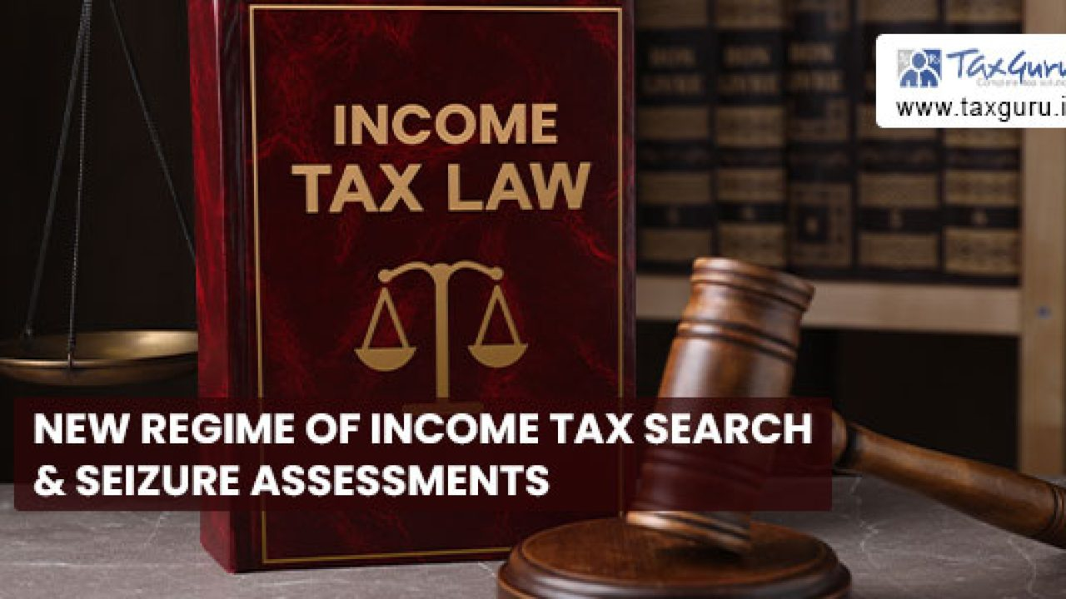
Income Tax Search and Seizure Assessments brought in the statute by virtue of the Finance Act’2021:-
Section 148 of the Income Tax Act’1961: “ Issue of Notice where income has escaped assessment”
The erstwhile Section 148 of the Income Tax Act’1961 has been substituted by a distinct Section 148 viz.
“Issue of Notice where income has escaped assessment.” Under the newly substituted Section 148, Explanation 2 has been brought into place to cover search, survey or requisition cases initiated or made or conducted, on or after 1st April 2021,
wherein it shall be deemed that the Assessing Officer has information which suggests that the income chargeable to tax has escaped assessment in the case of the assessee for the
three assessment years immediately preceding the assessment year relevant to the previous year in which the search is initiated or requisition is made or any material is seized or requisitioned or survey is conducted.

Slide 25
Income Tax Search and Seizure Assessments brought in the statute by virtue of the Finance Act’2021:-
Section 148A of the Income Tax Act’1961: “ Conducting inquiry, providing opportunity before issuing of notice under Section 148”
The Finance Act’ 2021, inserted a new Section 148A which mandates that before issuance of notice under Section 148, the Assessing Officer shall conduct inquiries if required
and provide an opportunity of being heard to the assessee. After considering his reply, the Assessing Officer shall decide, bypassing an order, whether it is a fit case for the issue of notice under section 148 and serve a copy of such order along with such notice on the assessee.
The Assessing Officer shall before conducting any such enquiries or providing an opportunity to the assessee or passing such order obtain the approval of the specified authORITY.
Most important to note here is that this procedure of enquiry, providing opportunity and passing order, before issuing notice under section 148 of the Act, shall not be applicable in search or requisition cases. {Emphasis Supplied}

Slide 26
Income Tax Search and Seizure Assessments brought in the statute by virtue of the Finance Act’2021:-
Section 149 of the Income Tax Act’1961: “Time limit for notice”
The erstwhile Section 149 of the Income Tax Act’1961 has been substituted by a distinct Section 149. The newly substituted Section provides that in normal cases, no notice shall be issued if three years have elapsed from the end of the relevant assessment year.
However, notice beyond the period of three years from the end of the relevant assessment year but not beyond the period of ten years from the end of the relevant assessment year can be issued only in a few specific cases where the Assessing Officer has in his possession books of accounts or other documents or evidence which reveal that the income chargeable to tax, represented in the form of asset, which has escaped assessment amounts to or is likely to amount to fifty lakhs rupees or more for that year.
Interestingly, the first proviso to sub-section (1) of Section 149 provides that no notice under section 148 shall be issued at any time in a case for the relevant assessment year beginning on or before 1st day of April 2021
Furthermore, the second proviso also clarifies that Section 149(1) shall not apply in cases where search has been initiated on or before 31st March’2021

Slide 27
Income Tax Search and Seizure Assessments brought in the statute by virtue of the Finance Act’2021:-
Section 153A, 153B, 153C and 153D of the Income Tax Act’1961:
“Section 153A:Assessment in case of search or requisition” and Section 153C: Assessment of income of any other person” have been suitably amended by inserting a sunset clause so far as the they shall cease to operate for searches initiated on or after 01st April’2021.
Accordingly, “Section 153B: Time limit for completion of assessment under
Section 153A” and “Section 153D: Prior approval necessary for assessment in case of search or requisition” shall also become otiose and thus not applicable for searches initiated on or after 01st April’2021.

Slide 28

NOTIFICATION & CIRCULARS
The Hon’ble Union Finance Minister Nirmala Sitharaman had presented the Union Budget 2021 of India on the 1st of February 2021. In significant changes to the taxation process, among other tax measures, the Hon’ble Finance Minister recommend paradigm changes to the provisions relating to Assessment in case of Search or requisition. The Finance Bill, 2021 received the Assent of the President on 28th March 2021 and thereafter became FINANCE ACT, 2021 (NO. 13 OF 2021).

Slide 29
NOTIFICATION & CIRCULARS
Changes proposed by the Finance Bill, 2021
They escaped the assessment and in search and seizure cases. The Explanatory Memorandum stated that the new scheme of assessment would result in less litigation and would provide ease of doing business to the taxpayers. The Finance Bill substituted existing Sections 147, 148, 149 and 151 and inserted a new section 148A making a complete change in the assessment proceedings relating to income escaping assessment and search-related cases. Consequential amendments have also been proposed to Section 151A, 153A and 153C.The Finance Bill, 2021 proposes a new re-assessment procedure for an income which

Slide 30
NOTIFICATION & CIRCULARS
The new Section 147 provides that the Assessing Officer can make the re-assessment of an income escaping assessment if the following conditions are satisfied:
Any income chargeable to tax has escaped assessment for any assessment year; and
The assessing officer follows the provisions of sections 148 to 153.
If the above conditions are satisfied, the assessing officer can assess or reassess such income or recompute the loss or the depreciation allowance or any other allowance or deduction for such assessment year. It is imperative to note that in view of Explanation to Section 147 the Assessing Officer can assess or reassess all those incomes which have escaped assessment and which come to his notice subsequently in the course of such proceeding notwithstanding that the procedure prescribed in section 148A was not followed before issuing such notice for such income.

Slide 31
NOTIFICATION & CIRCULARS
*Information suggests income escaping in case of Survey
The new scheme of reassessment proposes that the Assessing Officer can initiate the proceedings if he has the information which suggests that some income has escaped the assessment. Explanation 1 and 2 of the proposed Section 148 define the situation in which an assessing officer shall be deemed to have the information which suggests that the income chargeable to tax has escaped the assessment.
Explanation 2 applies in the case of search, survey or requisition of books, documents or other assets. Explanation 1 applies in other cases.

Slide 32
NOTIFICATION & CIRCULARS
In search, survey or requisition cases initiated or made or conducted, on or after 01-04-2021, it shall be deemed that the Assessing Officer has information which suggests that the income chargeable to tax has escaped assessment in the case of the assessee for the 3 assessment years immediately preceding the assessment year relevant to the previous year in the following cases:
A search is initiated under Section 132 or books of account, other documents or any assets are requisitioned under Section 132A, on or after the 01-04-2021, in the case of the assessee;
A survey is conducted under section 133A in the case of the assessee;
The Assessing Officer is satisfied, with the prior approval of PCIT or CIT, that any money, bullion, jewellery or other valuable article or thing, seized or requisitioned in case of any other person on or after the 01-04-20201, belongs to the assessee; or
The Assessing Officer is satisfied, with the prior approval of PCIT or CIT, that any books of account or documents, seized or requisitioned in case of any other person on or after 01-04-2021, pertains or pertain to, or any information contained therein, relate to, the assessee.

Slide 33
NOTIFICATION & CIRCULARS
The Finance Bill (Lok Sabha) has excluded the survey under Section 133A(2A) and Section 133A(5) from the scope (point (b) mentioned above). Therefore, in the following surveys conducted under Section 133A, it shall not be deemed that the Assessing Officer has information that suggests that the income chargeable to tax has escaped assessment.
Survey for verifying that tax has been deducted or collected at source in accordance with the provisions of sub-heading B of Chapter XVII or under sub-heading BB of Chapter XVII.
Survey at any function, ceremony, or event where having regard to the nature and scale of expenditure incurred by an assessee.
In other words, the assessing officer cannot initiate re-assessment proceedings merely based on the survey conducted in the above two cases.

Slide 34
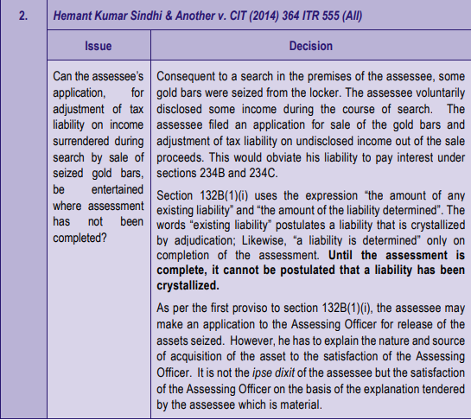
SIGNIFICANT CASE LAW UNDER SEARCH AND SEIZURE UNDER INCOME TAX ACT,1961

Slide 35
Validity of search warrant cannot be lightly questioned :
There should be a basis for the issue of the search warrant but such basis need not be disclosed to the assessee. Mere assertion on the part of the assessee regarding validity will not be acceptable.¹
^{No power to arrest:}
There is no power contained in the act or the rules whereby the movement of the
person against whom the search is ordered can be restricted.2
A self-contained provision:
Section 132 is essentially a procedural section.³
1.Harbhajan Singh Chadha v DIT (2016) 380 ITR 100 (All)
2. Gupta (L.R.) v Union of India (1992) 194 ITR 32(Del) (SLP granted to Department)
3.Director of Inspection v K C & Co. (1990) 185 ITR 475 (J&K)

Slide 36
Scope and applicability of the provision:
The books and documents, seized, are intended to be used and can only be used as evidence in connection with a pending normal assessment or a proposed reopening of assessment or a reassessment under section 147.
That a post-search assessment should be confined to interference on the basis of incriminating material during search and not any report of valuation officer subsequently obtained in the assessment under section 158BB.1
Loose sheets of paper with a rough noting's and scribbling by an anonymous person seized during the course of search of another person cannot be treated as admissible documents for determination of source.²
1.CIT v N K Laminates P Ltd(2014) 365 ITR 211(All)
2.ACIT v Layer Exports P LTD(2017) 53 ITR (Trib) 416 (Mum)

Slide 37
Pendency of proceedings not a sine qua non:
Search warrants cannot be issued with a view to making a roving and fishing enquiry.¹
Narrow construction to be avoided:
Seizure can be affected even from the custody of a person other than a person who has failed to disclose his income and from a building belonging to a person other than a defaulter.
Rule of harmonious interpretation:
It has been held that the provisions of section 132 should be construed harmoniously in order to give effect to the intention of the legislature to bring to tax undisclosed income or property.²
Bharti Pvt Ltd v Chadda (R S)(1973) 89 ITR ITR 108(Cal)
Noor Mohd Rahimatulla Gillani v CIT(1976) Tax LR 688(Bom)

Slide 38
Constitutionality:
The supreme court in Bhupendra ratilal Thakkar v CIT.
^{Inbuild safeguards:}
In ITO v Seth bros the supreme court made it clear that section 132 does not confer any arbitrary authority upon the revenue officers.1
Warrant of authorization in the name of one or more person:
The law does not require a copy of the warrant of authorization to be delivered or furnished to the person against whom it is issued.²
1.(1976) 74 itr 836 (sc).
2. Southern herbals ltd v DIT (Inv) (1994)207 ITR 55(Kar).

Slide 39
Existence of information:
The information would mean a statement of facts.¹
“Satisfaction note” cannot constitute “Information”
.The information must be something more than a rumor or a gossip or a hunch.³
Whether warrant should be separate for each assessee:
The issue of a single warrant mentioning the assessees functioning in the same premises was held to be valid.4 reversing the decision of the tribunal.
1.This word has also been used in section 147, post.
2.Janak raj sharma v DIT (1995) 215 ITR 234(P&H
^{3.(IBID)}
4.CIT v Khyber Foods (2012) 346 ITR 36 (Ker)

Slide 40
Are non-residents immune from search:
The rajasthan high court.¹upheld in the search in the case of non-resident Indian carrying on business in Nepal. The provisions do not make any difference between residents and non-residents
Section 132 versus section 147:
In CIT v Thippa Shetty (Dr.N).2
Section 132 versus section 153A:
Section 153A authorizes post search notice for assessment on a year-wise basis substituting pre-existing block assessment scheme.³the jurisdictionfor such a post search assessment is wide,since all the pending assessment get abated.
1.Ram kumar dhanuka v union of india (2001) 252 ITR 205(Raj)
^{2.(2010) 322 ITR 525 (Kar)}
3.All the cargo global logistics lst v DIT (2012) 18 ITR(TRIB) 106(Mum)(SBI)

Slide 41
Completion of search in reasonable time:
High court v Balakrishnan Nair (Dr. c) reversed the judgement aceepting the departmental explanation and there was no unreasonable delay.¹time limit for completion of a block assessment runs from the date on which the last panchanama was executed to make the search complete
^{Recording of statements:}
The use of such statement or materials procured by search and seizure against the person is not and assused as contemplated in the article.2
A statement which is not a substantiated cannot be taken as binding on the assessee.3
The statement may also not be acceptable in the absence of cross-examination.4
1.(2006) 282 ITR 158 (Ker)
2.See Dwarka prosad agarwalla v director of inspection (1982) 137 ITR (AT) 128 (Del)
3.CIT v Balasubramanium (P.) (2013) 354 ITR 116
4.Apeejay Education Society v ACIT (2016) 51 ITR (Trib) 5 (Amritsar).

Slide 42
Explanation regarding valuables seized:
Where the assesse is able to show that the jwellery was in his possession even earlier and has an explanation for the same, the explanation for the same. Since only minimum penalty has been leived,upheld in Rajaswamy (p.) v CIT¹
^{Opportunity of being heard:}
Failure of the assessing officer to give a reasonable opportunity to the assessee has been held to contravene the principles of natural justice.2
Inspection of seized books or documents:
The person from whose custody the books are seized under sub section (1) or sub section (1a) may take copies thereof in the presence of the authorised officer.³
1.Laljibhai K Soni v ACIT (1995) 213 ITR 114 (Guj)
2.Gulab & Co. v Superintendent of central excise (preventive), Trichy (1975) 98 ITR 581
3.Manik Chand Gupta v CIT (1988) 173 ITR 662(AII)

Slide 43
Provisional attachment of property:
The authorised officer for estimation of fair market value of a property, may make a reference to a valuation officer referred to the section 142A, for valuation in the manner provided under the said sub-section.
Code of Criminal Procedure to apply:
It is only intended that the officer concerned shall issue the necessary warrant. Keep present respectable of the locality to witness the search and generally carry out the search in the manner provided by the code criminal procedure.1
1.Originally the code of criminal procedure, 1895 (5 of 1898), now the code of criminalprocedure 1973 (2 of 1974).

Slide 44

LATEST NEWS case of certain foreign-controlled mobile communication and handset makers
The income tax department said that search and seizure operations across the country in the case of certain foreign-controlled mobile communication and handset makers have led to detection of certain inappropriate transactions, non-compliance of certain disclosure requirements, inflation of expenses, and use of funds of doubtful source.
The searches were conducted in Karnataka, Tamil Nadu, Assam, West Bengal, Andhra Pradesh, Madhya Pradesh, Gujarat, Maharashtra, Bihar, Rajasthan, and Delhi.

Slide 45

LATEST NEWS
WHAT THE CHINESE CO. HAS TO SAY
the searches had covered suppliers of Chinese mobile phone brands OPPO, Xiaomi, and OnePlus. The spokesperson for Xiaomi then said the company gives importance to remaining fully compliant with all laws. The OPPO spokesperson said in an email that, as an invested partner in India, it respects and abides by the law of the land

Slide 46

LATEST NEWS
WHAT THE SEARCH MEMBER HAS TO SAY
The searches have revealed that two major companies have made remittances in the nature of royalty to and on behalf of its group companies located abroad, which aggregate to more than ₹5,500 crore, the income tax department said without naming any company.
“The claim of such expenses does not seem to be appropriate in light of the facts and evidence gathered during the search," the department said.

Slide 47

LATEST NEWS
WHAT IMPLIES TO INCOME TAX ACT
“Both these companies had not complied with the regulatory mandate prescribed under the Income-Tax Act for disclosure of transactions with associated enterprises. Such a lapse makes them liable for penal action under the Income-Tax Act, the quantum of which could be more than ₹1,000 crore," the department said.
The search has brought to fore how foreign funds, the source of which is doubtful, have been introduced in the books of one of the Indian companies, the tax authority also said. The quantum of such borrowings is about ₹5,000 crore, on which interest expenses have also been claimed, the department said.

Slide 48
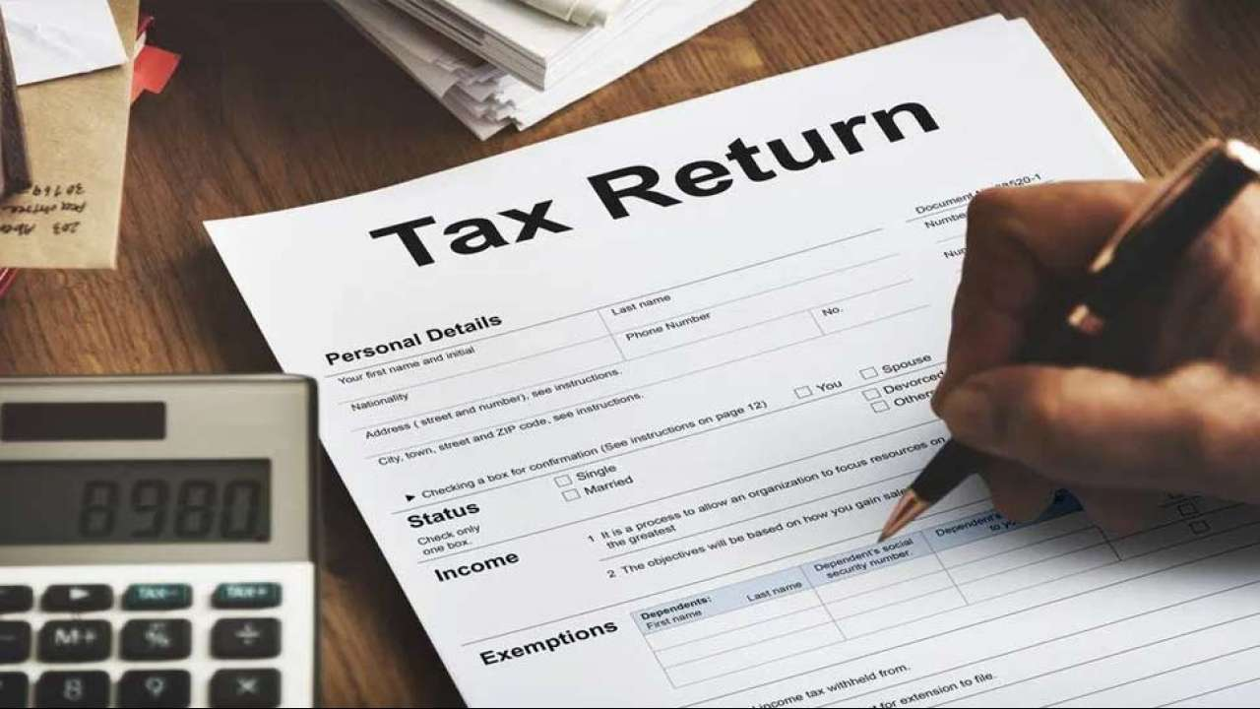
LATEST NEWS
CLAIM OF INTERSEST ON SUCH LOAN AND REDUCTION IN
TAXABLE PROFITS LEAD TO LOWING PROFITS
The evidence of inflation of expenses and payments on behalf of the associated enterprises have also been noticed, which led to the reduction of taxable profits of the Indian mobile handset manufacturing company, the department said. The amount could be in excess of ₹1,400 crore, the department said.

Slide 49
LATEST NEWS
OUTCOMES FROM SEARCH
In case of the other company covered in the search action, it has been detected that the control of the affairs of the company was allegedly managed substantially from a neighbouring country, the department said.
Survey action in the case of certain fintech and software services companies have revealed that a number of such companies have been created for inflating expenses and siphoning out funds, the department said.

Slide 50

Govt detects undisclosed income of Rs 20,078 crore in Panama Leak
The government has filed 107 prosecution complaints — or chargesheets — under the new Black Money Act and detected undisclosed income of approximately Rs 20,078 crore in the Panama Papers Leak case, the government informed Parliament In JULY
While giving details of the government’s actions in different cases under the Black Money Act, 2015, Pankaj Chaudhary, minister of state for finance, said there was no official estimate of the black money stashed in the Swiss Bank for the past 10 years.

Slide 51
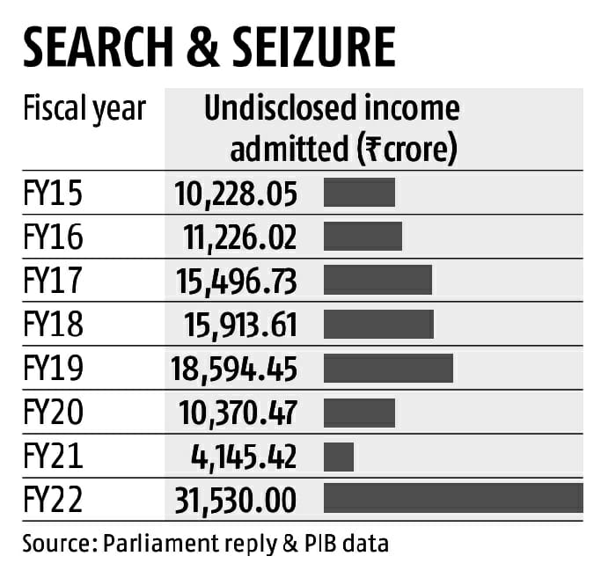
Searches at a new high as tax offences get money-laundering tint
The Central Board of Direct Tax
(CBDT) has set a record for search
operations against “undisclosed
income” in FY22. With three months
left until the end of the fiscal year, the
total “undisclosed income” as per publicly available data is about ~32,000
crore, far eclipsing the level set in FY19, when it was just under ~18,600 crore.

Slide 52

Read it along with the expanded
“predicate offences” powers of its brother department, the Enforcement Directorate (ED)
The figures reflect the expanded powers the tax department has amassed in a relatively
short period. It began with the Finance Act of 2015, when the government brought in the Black Money (Undisclosed Foreign Income and Assets) and Imposition of Tax Act, 2015. The penal provisions of the Act connect with those of the
Prevention of Money Laundering Act,
which meant that any evidence of foreign income that was not taxed would qualify as an offence of money
laundering.

Slide 53

Benami transactions(prohibition) act interplay
In rapid succession came the Benami Transactions (Prohibition) Amendment Act of 2016 and then the Finance Act of 2017 that connected PAN numbers with Aadhaar. The Finance Act of 2017 also removed the need for tax officials to declare to a court why they believe a search operation on someone is necessary. Next year’s Finance Act disallowed the scope for tax offenders under Benami
or
Black Money law to pay a higher penalty and getaway. The government also enacted the Fugitive Economic Offenders Act, 2018, to go after those who have fled abroad in tax cases worth more than ~100 crore. The stakes were, therefore, raised for tax offences, since in most search operations, the charge for hiding income in foreign shores was always attached.

Slide 54
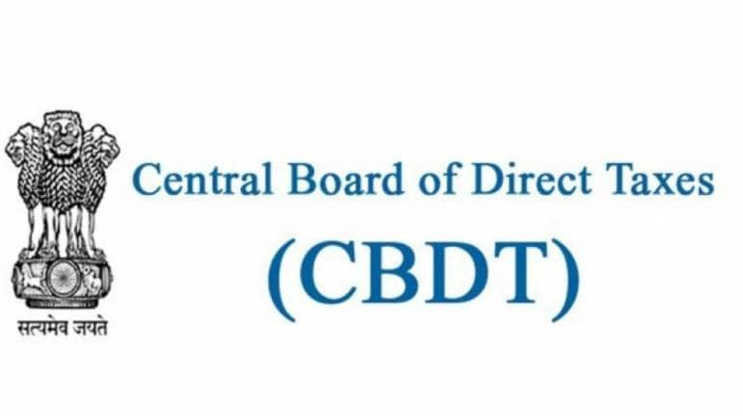
tax officials can dig up evidence that corroborates their hunch.
Instead of having to prove in courts that there was sufficient reason to make out a case for survey or search operation, the CBDT has allowed its officers to “deem” that they have plausible information “that suggests that the income chargeable to tax has escaped assessment” for three previous years. This means a search operation on someone can begin with the assumption the assessing officer knows why she\he is doing so. With the wide leeway having reached the office or residence of the assessed, the tax officials can dig up evidence that corroborates their hunch.

Slide 55

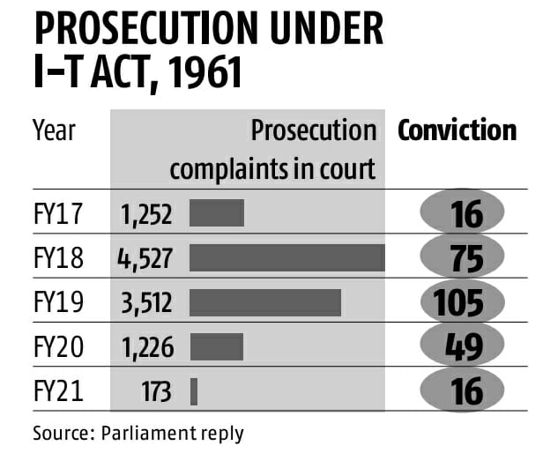
Money laundering charges stands a better prosecution chance in court
the CBDT hopes it will also overcome its dismal score sheet to prove satisfactorily to the courts that these cases were genuine ones of tax evasion. In FY20, CBDT filed over 1,225 prosecution complaints but could get a conviction for only 49 people. Money laundering charges stand a better chance through the courts.

Slide 56

SEARCH FOR TAX EVASION
INDIA NEEDS TO EXPAND ITS TAX BASE
Government finances this year have benefitted from a higher than expected revenue collection. While the third wave of the pandemic and associated disruption in economic activity would have an impact, the broad trend in tax collection is widely expected to continue this year
As the latest numbers show, the Central government’s fiscal deficit at the end of November was at 46.2 per cent of the Budget estimates. The comparable number in 2019-20 was 114.8 per cent. However, better than expected revenue collection has not affected the enthusiasm of the income tax department to look for undisclosed income.

Slide 57
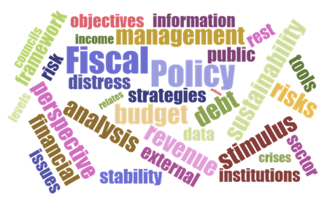
Increased levels of searches highlights the basic weakness in india fiscal managemnt
Although tax collection has improved significantly this year, it remains to be seen if the buoyancy continues in the medium term and decisively pushes up the overall tax-to-gross domestic product (GDP) ratio.India’s slow and stagnant tax-to-GDP ratio puts pressure on government finances and limits the capacity of both the Central and state governments to spend on developmental needs.

Slide 58
Increased levels of searches highlights the basic weakness in india fiscal managemnt
Besides recent legislation to unearth black money and benami transactions, the Finance Act, 2017, did away with the need for tax officials to declare to a court as to why in their opinion a search is necessary. Tax officials have now been given the powers to do so if they believe to have plausible information that in come has escaped assessment over the last three years. This has predictably increased the level of searches and will affect taxpayers.

Slide 59
Piyush Jain
Into manufacturing of Shikhar Pan Masala and dealer in perfumes.
23 kgs of gold, worth Rs.200 crores and 600 kgs of sandal wood was recovered
The businessman used an old scooter and stayed at Kannauj, Kanpur
The businessman was arrested u/s.132 of CGST Act

Slide 60
Piyush Jain
The actual stock kept at the factory was tallied with the stock recorded in books of accounts. The authorities found a shortage of raw material and finished products.
This corroborated that the manufacturer was indulging in wrongful removal of goods with the help of transporter, who used to issue fake invoices.
Authorities seized Rs.250 crores cash.

Slide 61
Pushpakraj Jain
Also known as Pampi Jain
Rs. 150 crores of tax evasion found.
There existed a joint venture between Pampi Jain and Bhoomi Developers.
Pampi launched the “Samajwadi Ittra” a perfume in the month of December 2021.

Slide 62
Pushpakraj jain
Stock manipulation, fudging of accounts (shifting of profits from taxable unit to exempt unit) and regular tax evasion was found.
Inflation of expenses, cash sales of about 35-40% was found.
Unaccounted income was invested in real estate in Mumbai.
Acquisition of properties in India and UAE.
The Offshore entities were not declared in Schedule FA of the Income Tax return.

Slide 63
Ajay Chaudhary
Owner of ACE Builder Group.
Close to Samajwadi party, and a prominent builder in the LCR region.
The Income Tax raids were conducted together information on the money transactions of the Builder.
The Income Tax department has a doubt regarding tax evasion and after getting more information they decided to conduct a raid.
The department is examining the hard disk and the digital equipment's of the builder. They are also examining the balance sheet of the company.

Slide 64
Skandhanshi Infra projects.
Income Tax searches were conducted on January 6, 2022 on the company and Raga Mayuri Developer and Nabya Developers.
A large amount of cash was seized.
The department is examining several real estate transactions

Slide 65
Dainik Bhaskar
The Income Tax searches were conducted on the DB Group allegedly for pointing out “true pictures of GOI inefficiency before the country during the second wave of Covid 19”.
The department found huge tax evasions, bogus expenses and purchases using shell companies.
The DB Group had floated several paper companies, with their employees as shareholders and as directors.
The money was syphoned off and routed back into various personals and business investments.

Slide 66
Big data analytics
The Income Tax department has been heavily relying upon risk based tax audit.
The department is using big Data Analytics and also using deeper data mining methodology for conducting Income Tax searches on the assesses.

Slide 67
Saravana Super stores
Income Tax department conducted searches on 7th December, 2021.
Rs.10 crores cash and Rs.6 crores of Jewellery which was unaccounting was found.
Large scale manipulation of books of accounts was found.
Suppression of sales of more than Rs.1000 crores was found.
Cash purchases of more than Rs.150 crores in textiles was found.

Slide 68
Saravana Super stores
Bogus bills of more than Rs.80 crores was found.
Unaccounted purchase of gold was found.
The company inflated manufacturing expenses of Jewellery.
Unaccounted rental receipts were found.
Unaccounted scraps of more than Rs.7 crores was found.

Slide 69
Stainless companies in Gujarat.
In December, 2021 the Income Tax department found unaccounted transactions of more than Rs.500 crores in companies who manufactures stainless steel and metal pipes.
Unaccounted sales of goods and scrap sales in cash which was not accounted was found.
Unaccounted cash loans and advances, interest earned thereon was found.
Expenses in cash, bogus expenses, bogus purchases, unaccounted land investment details were found during the course of the raids.

Slide 70
Deleted Whatsapp messages
The Income Tax Department recovered deleted WhatsApp messages and unearthed various evidences of obtaining huge accommodation entries (bogus business entries in books of accounts) by the said stainless steel company to reduce the income tax liability.

Slide 71
Maharashtra urban credit coop. bank.
The Income Tax department carried out search and seizure operations at the HQ and branches of the above bank and restrained Rs.553.72 crores in October 2021.
The department on the basis of bank data on core banking solutions and statements of key managerial personnels revealed glaring irregularities in opening bank accounts.
More than 1200 new bank accounts were opened without PAN and without following KYC documentation

Slide 72
Maharashtra urban credit coop. bank
More than 700 bank accounts have been identified in which cash deposits of more than Rs.34.10 crores were made immediately within 7 days of opening the bank accounts.
These deposits have been structured to avoid mandatory PAN requirement for cash deposits above Rs.2 lakhs.
The money was subsequently converted into fixed deposits in the same bank.

Slide 73
Maharashtra urban credit coop. bank
On further inquiries of such bank accounts the account holders have demonstrated that those persons are not aware of such cash deposits in the bank and categorically denied any knowledge of such bank accounts or even the fixed deposits.

Slide 74
LAPTOP firms
The Income Tax departments carried out search and seizure operations on several electronic importers and traders in the national capital region Haryana and West Bengal.
The evidence found and seized during the search revealed that the payments for such under invoiced goods to the foreign consignors have been made through Hawala channels.
Evidence of unrecorded transactions, bogus loans, unaccounted investments in properties was gathered during the search.

Slide 75
LAPTOP firms
Import worth of Rs.20 crores were declared at the port of entry in the past 3 years, however, the estimated value of the import is possibly more than Rs.2000 crores.
More than Rs.2.75 crores in cash was found to be unaccounted.
A Bill of Lading was declared with goods as “HDMI Cables” worth Rs. 3.8 lakhs was found, however, on further investigation the actual goods imported were high value items like laptop, mobile phones etc., worth more than Rs.64 crores

Slide 76
LAPTOP firms
The illegitimate wealth was used for acquisition of immovable properties, disguising of cash introduced in the form of bogus rental income, bogus unsecured loans and deposits in foreign bank accounts.

Slide 77
SONU SOOD
The Income Tax department found tax evasions of more than 20 crores.
The main modus operandi followed by the actor has been to route his unaccounted income in the form of bogus, unsecured loans from many bogus entities.
On examination the providers have accepted on oath to have given bogus accommodation entries. They have accepted to have issued cheques in lieu of cash.
There have been instances where professional receipts have been camouflaged as loans in the books of accounts for the purpose of tax evasion.

Slide 78
SONU SOOD
The bogus loans were used for making investments and acquiring properties.
The charity foundation incorporated by the actor on July 21, 2020 had collected donations of Rs. 18.94 crores of which it spent Rs. 1.9crores towards relief work and the balance 17 crores were lying in the foundation bank account.
Amount of Rs. 2.1 crores have also been raised by the Charity foundation from overseas donors on crowd funding platform in violation of FCRA.

Slide 79

THANK YOU

